Slide 1
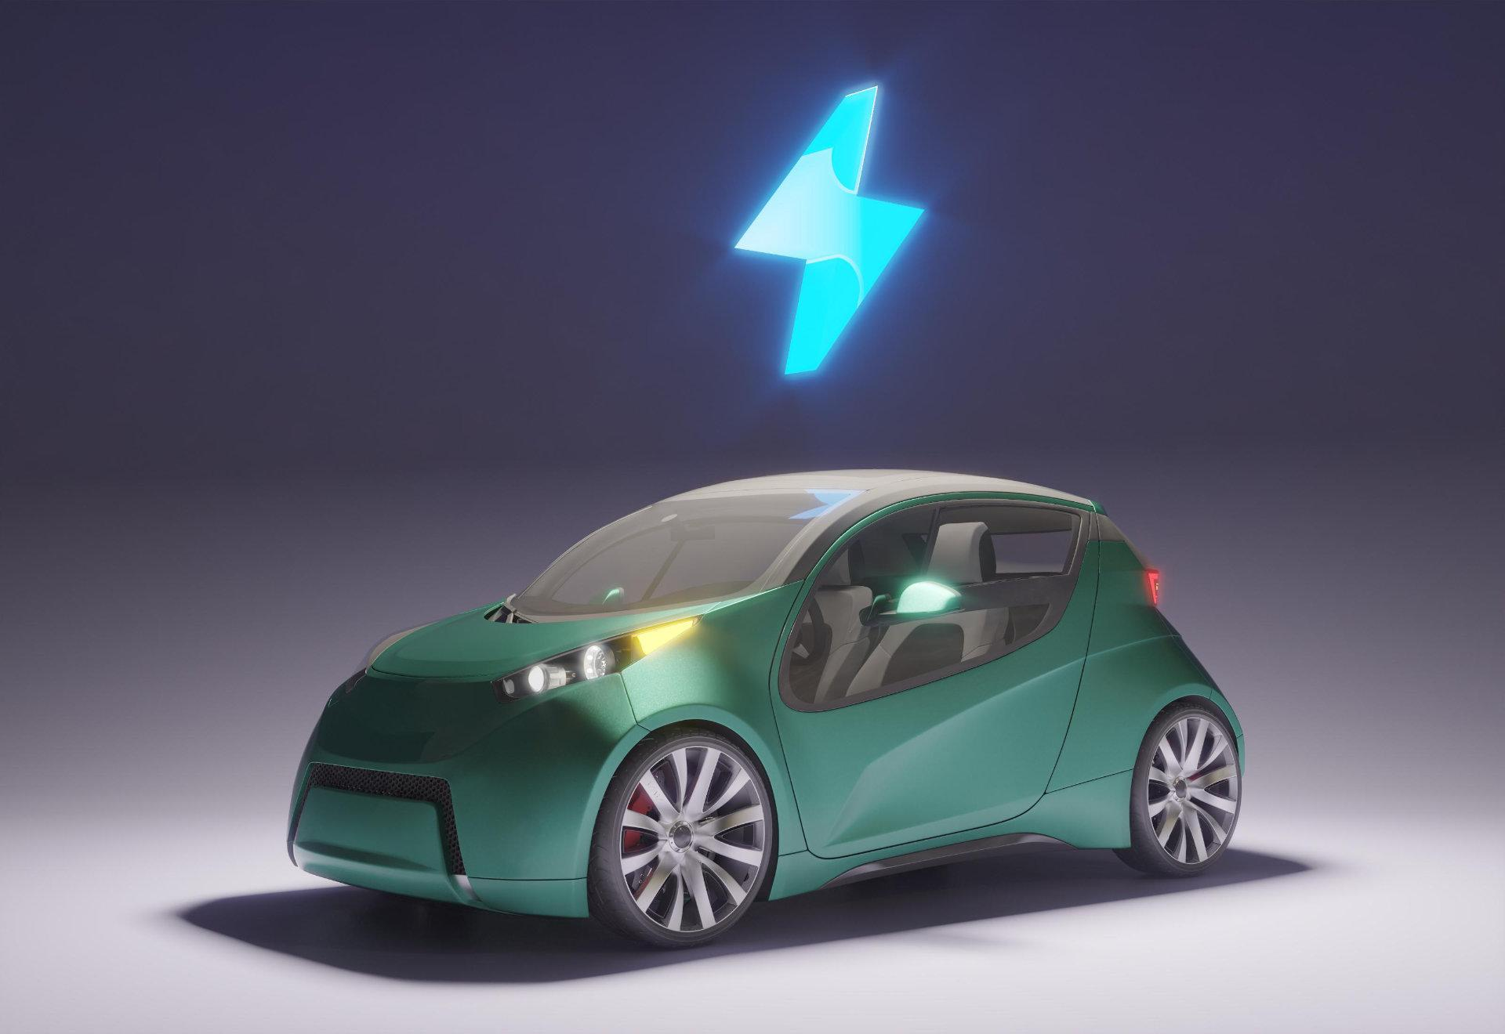
VC VEHICLE
Robotic Car Controlled by Voice Command

Slide 2
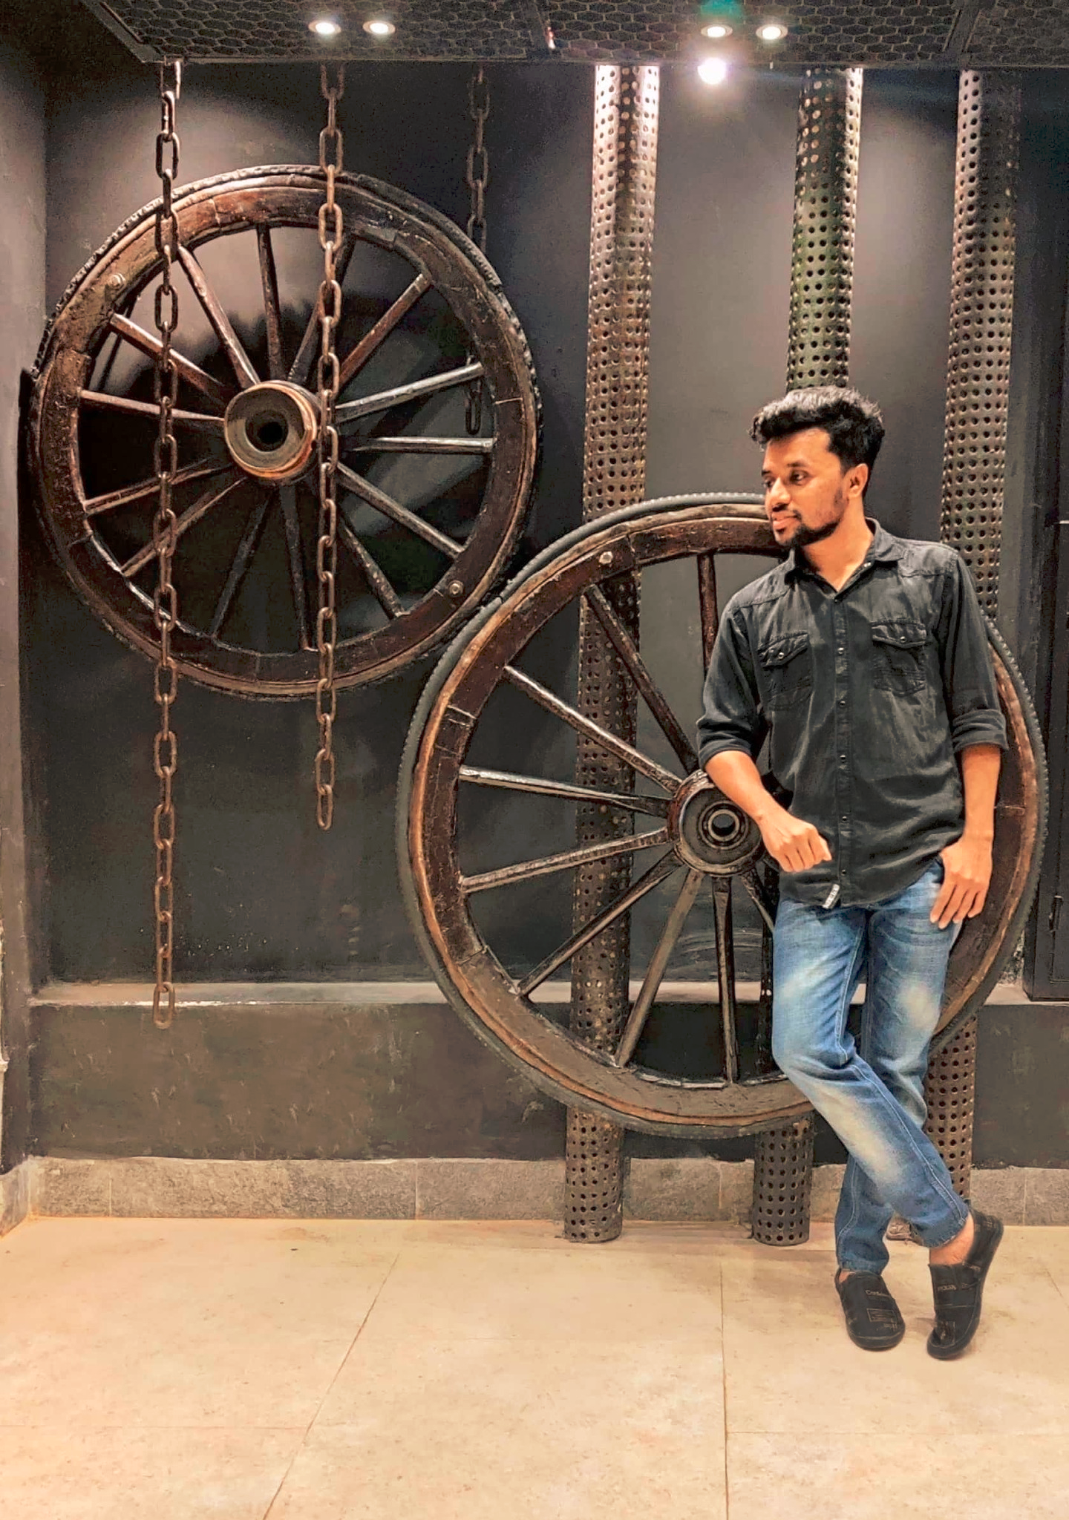


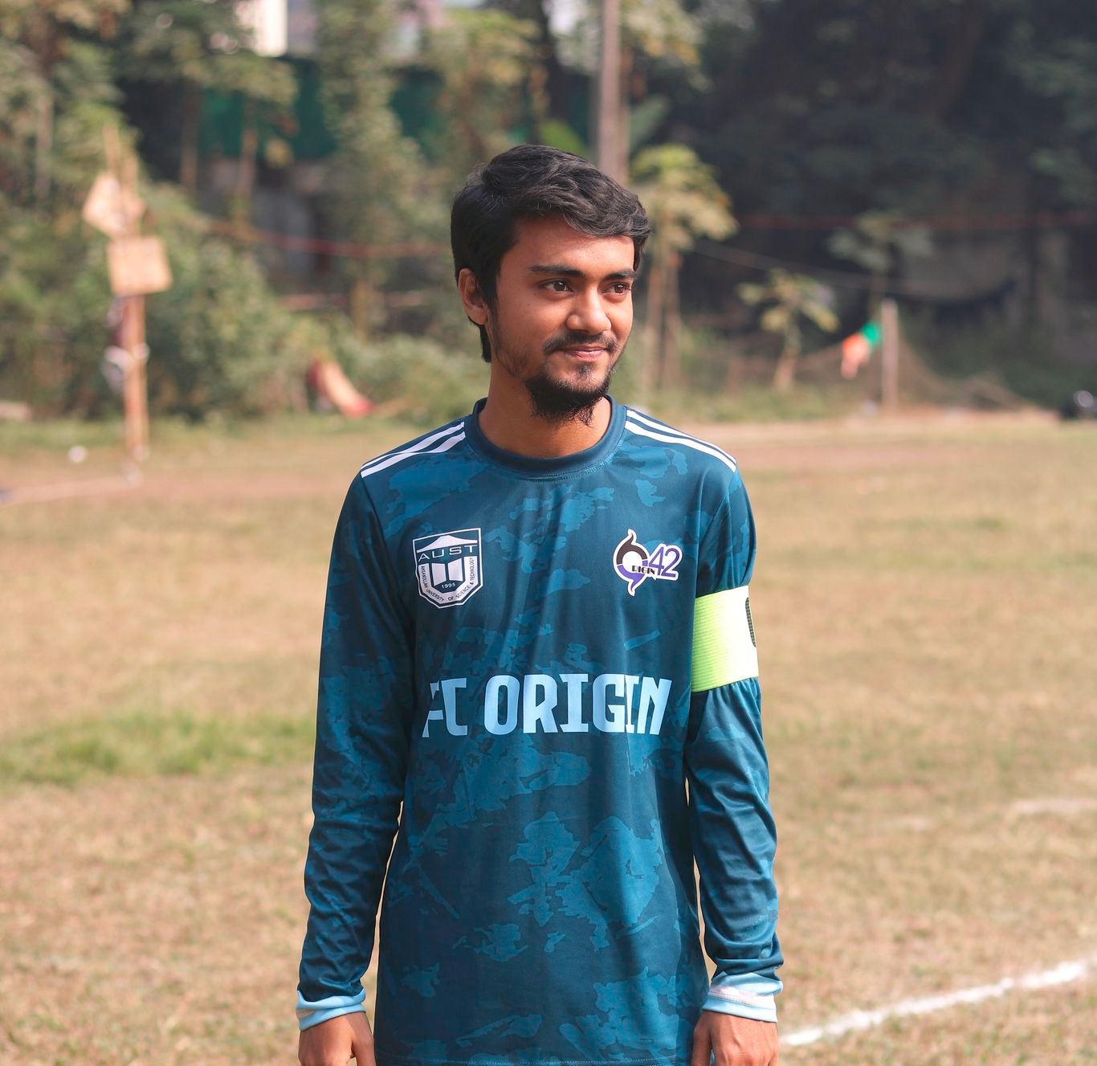
MEET THE TEAM
Shahadat Hossain
Afroja Akter
Mariam Akter
Rahat Chowdhury
180204088
180204089
180204115
180104131

Slide 3
OBJECTIVE
This project Voice Controlled Robotic Vehicle helps to control robotic vehicles through voice commands received via android application. The integration of the control unit with the Bluetooth device is done to capture and read the voice commands. The robotic vehicle then operates as per the command received via android application.

Slide 4
SOCIAL VALUES
01
02
03
04
05
06
Budget Friendly
Distance Networking
Unreachable Zone
Preset Commands
Security & Other Purpose
Support Disabled People

Slide 5
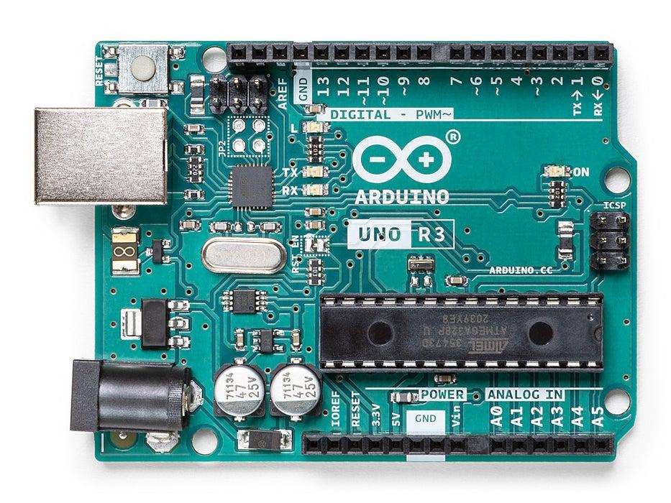
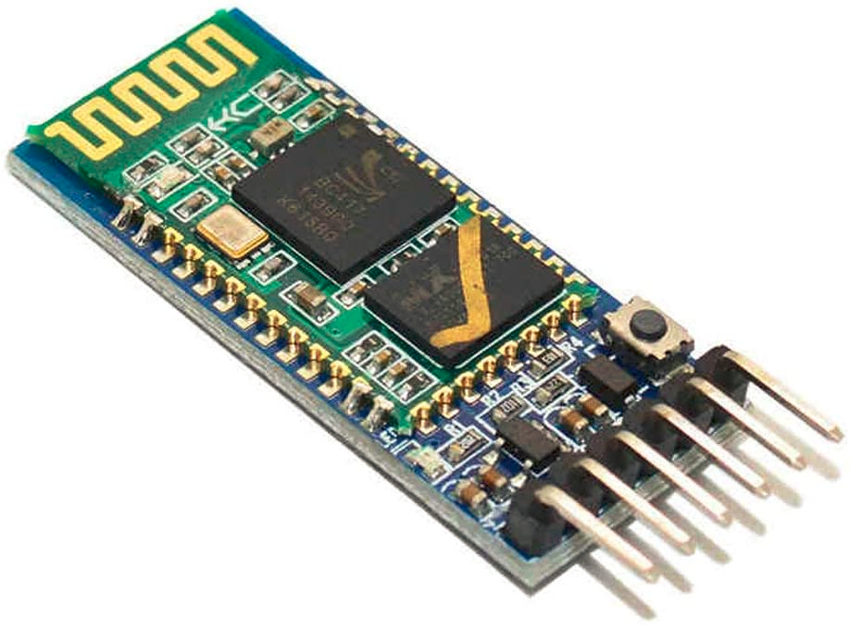
Required Components
Arduino UNO Board
ATmega328P Microcontroller
Robotic Chassis
DC Motor
Motor Driver IC
Voltage Regulator IC
Bluetooth Module
Resistors
Capacitors
Transistors
Cables and Connectors
Diodes
PCB and Breadboards
LED
Transformer/Adapter
Push Buttons
IC
IC Sockets
Battery

Slide 6
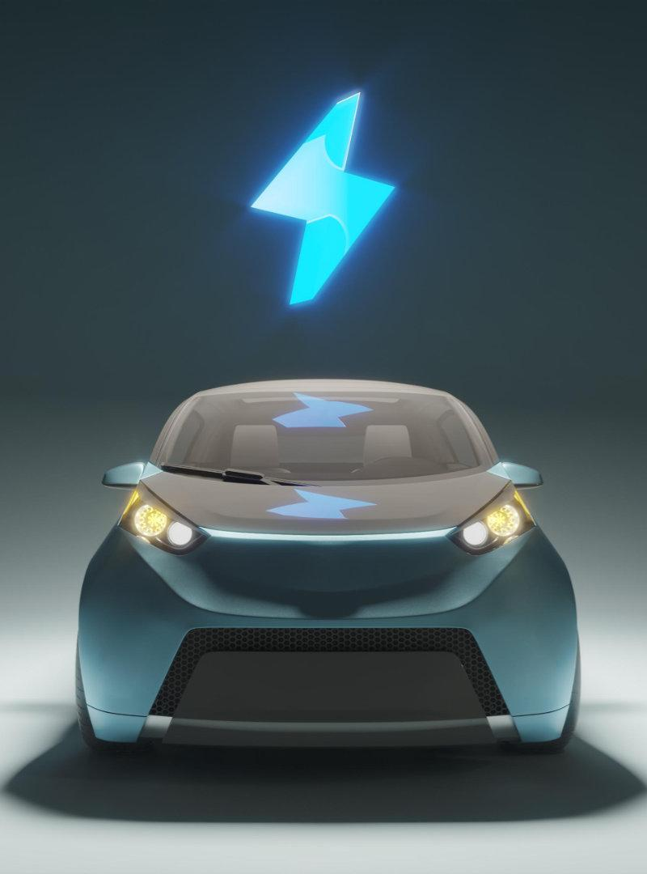
ESTIMATED BUDGET
The estimated budget for our “VC Vehicle” is BDT 3224.

Slide 7
WORKING PROCEDURE
01
02
03
04
Pair Bluetooth module with the mobile
Click on the “MIC” icon and instruct the robot
Install any Bluetooth Application for Arduino
On speaking, our speech gets recognized and converted into text. That text is transferred using Bluetooth
The BT Module receives the string, decodes and compares it with the given Instructions and moves the robot accordingly

Slide 8
CONCLUSION
01
02
CHALLENGE
GOAl
Still under development
Updated Technology in daily lives

Slide 9
ANY QUESTIONS?
THANK YOU!

